Slide 1



DATA HANDLING AND VISUALiSATION
PROJECT

Slide 2

title
Road accidents in india
2016-2019

Slide 3


About Dataset
The data refers to Total Number of Road Accidents, Persons Killed and Injured. It also provides some other information like Number of Accidents per Lakh Population, Number of Accidents per Ten Thousand Vehicles, Number of Accidents per Ten Thousand Kms of Roads, Number of Persons Killed Per Lakh Population, Number of Persons Killed Per Ten Thousand Vehicles.
Data of road accidents in India are collected by Transport Research Wing (TRW) of Ministry of Road Transport & Highways from the Police Headquarters of the various states, UTs and Million Plus cities in India.

Slide 4

SOURCE
Data gov in:
https://data.gov.in/resource/stateut-wise-total-number-road-accidents-india-2016-2019
COLLECTION METHODOLOGY
Released Under: National Data Sharing and Accessibility Policy (NDSAP) Contributor: Ministry of Road Transport and Highways Domain: Open Government Data (OGD) Platform India
Published On: 15/02/2023

Slide 5





Data
Visualisation 1
Data
Visualisation 2
Data
handling
Data
collecting
Data
import
Management of data
Project
Graphical representation of data
Collection of data
Mapping of data
importing python libraries
Data handling can result in efficient and economical storage, retrieval, and disposal of data.
Imports in Python are important for structuring your code effectively
Data visualization
removes the noise from data and highlights useful information.
Collect necessary data to work on it
The ability to absorb information quickly, improve insights and make faster decisions
overview

Slide 6
Data
Visualisation 1
Data
Visualisation 2
Data
import
Data
collecting
Data
handling
importing python libraries
Collection of data
Management of data
Graphical representation of data
Mapping of data
Project
Imports in Python are important for structuring your code effectively
Collect necessary data to work on it
Data handling can result in efficient and economical storage, retrieval, and disposal of data.
Data visualization
removes the noise from data and highlights useful information.
The ability to absorb information quickly, improve insights and make faster decisions
procedure

Slide 7
Data
Visualisation 1
Data
Visualisation 2
Data
handling
Data
collecting
Data
import
Graphical representation of data
Management of data
Collection of data
Mapping of data
importing python libraries
Data visualization
removes the noise from data and highlights useful information.
Data handling can result in efficient and economical storage, retrieval, and disposal of data.
Imports in Python are important for structuring your code effectively
Collect necessary data to work on it
The ability to absorb information quickly, improve insights and make faster decisions

Slide 8
Data
Visualisation 1
Data
Visualisation 2
CODE
Data
handling
Data
import
Data
collecting
import numpy as np # linear algebra
import pandas as pd # data processing
import matplotlib.pyplot as plt
from sklearn.preprocessing import StandardScaler
from sklearn.model_selection import train_test_split
import seaborn as sns
importing python libraries
Graphical representation of data
Management of data
Collection of data
Mapping of data
Imports in Python are important for structuring your code effectively
Data visualization
removes the noise from data and highlights useful information.
Data handling can result in efficient and economical storage, retrieval, and disposal of data.
Collect necessary data to work on it
The ability to absorb information quickly, improve insights and make faster decisions
OUTPUT
Imports in Python are important for structuring your code effectively. Using imports properly will make you more productive, allowing you to reuse code while keeping your projects maintainable.

Slide 9
Data
Visualisation 1
Data
Visualisation 2
Data
handling
Data
collecting
Data
import
Graphical representation of data
Management of data
Collection of data
Mapping of data
importing python libraries
Data visualization
removes the noise from data and highlights useful information.
Data handling can result in efficient and economical storage, retrieval, and disposal of data.
Collect necessary data to work on it
The ability to absorb information quickly, improve insights and make faster decisions
Imports in Python are important for structuring your code effectively

Slide 10
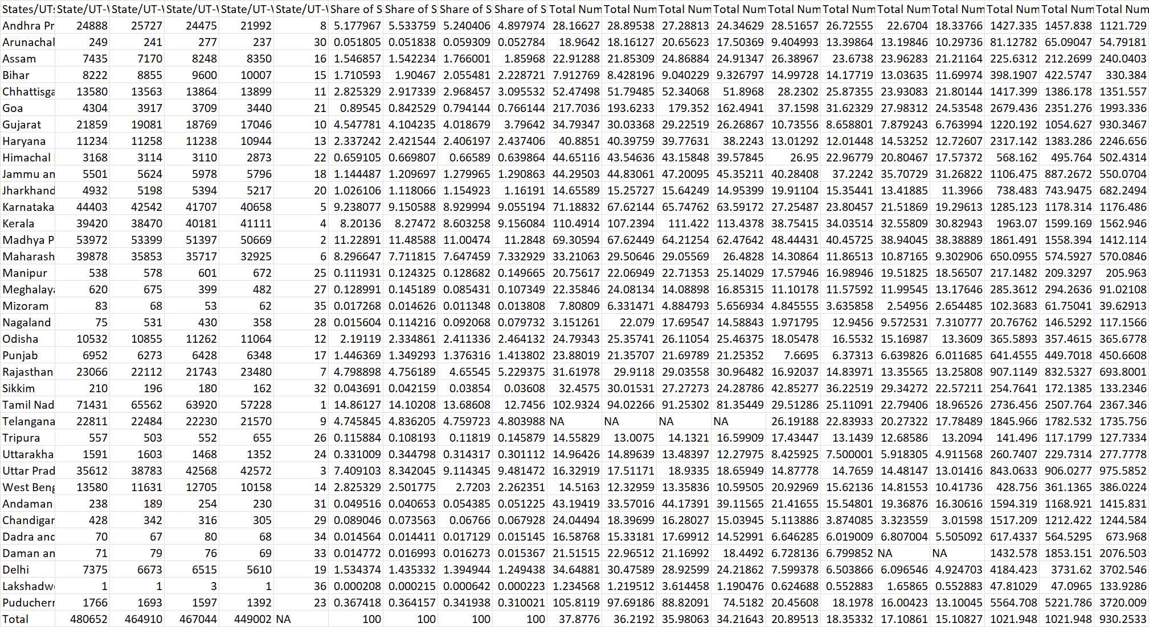
Data
Visualisation 1
Data
Visualisation 2
CODE
Data
handling
Data
import
Data
collecting
Data = pd.read_csv(r"C:\Users\pathi\OneDrive\Desktop\Road Accidents 2016-19.csv")
Data
OUTPUT
Collection of data
Graphical representation of data
Management of data
importing python libraries
Mapping of data
Collect necessary data to work on it
Data visualization
removes the noise from data and highlights useful information.
Data handling can result in efficient and economical storage, retrieval, and disposal of data.
Imports in Python are important for structuring your code effectively
The ability to absorb information quickly, improve insights and make faster decisions

Slide 11
Data
Visualisation 1
Data
Visualisation 2
Data
handling
Data
import
Data
collecting
Graphical representation of data
Management of data
Collection of data
Mapping of data
importing python libraries
Data visualization
removes the noise from data and highlights useful information.
Data handling can result in efficient and economical storage, retrieval, and disposal of data.
Collect necessary data to work on it
The ability to absorb information quickly, improve insights and make faster decisions
Imports in Python are important for structuring your code effectively

Slide 12
Data
Visualisation 1
Data
Visualisation 2
Handling the data
Data
handling
Code , overview & output
Data
collecting
Data
import
1. Data.isna()
# Method, that checks for missing or NaN (Not-a-Number) values within the data.
2. Data.info()
# It provides The total number of non-null (non-missing) values in each column,The data type of each colum,The memory usage of the DataFrame.
3. missing_val=Data.isna().sum()
missing_val
# It provides user with no of missing values within the data.
4. Data['Total Number of Accidents Per Lakh Population - 2016'].fillna(Data['Total Number of
Accidents Per Lakh Population - 2016'].value_counts().index[0],inplace=True)
Data.isna().sum()
#
5. Data.nunique()
# It provides no of unique values within the data
Management of data
Graphical representation of data
Collection of data
Mapping of data
importing python libraries
Data handling can result in efficient and economical storage, retrieval, and disposal of data.
Imports in Python are important for structuring your code effectively
Data visualization
removes the noise from data and highlights useful information.
Collect necessary data to work on it
The ability to absorb information quickly, improve insights and make faster decisions
This code fills missing values in a specific column with the most frequent value and checks for remaining missing values in the DataFrame.

Slide 13
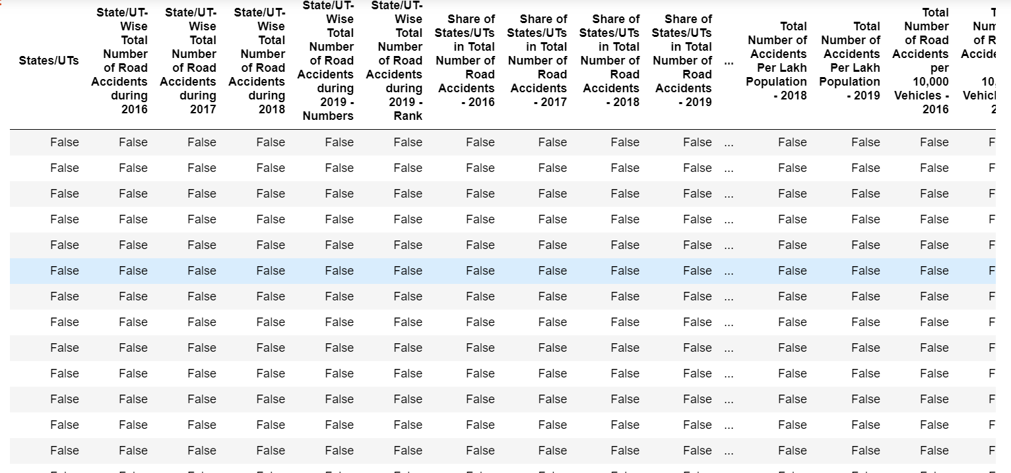
Data
Visualisation 1
Data
Visualisation 2
Data
handling
Data
collecting
Data
import
Management of data
Graphical representation of data
Collection of data
Mapping of data
importing python libraries
Data handling can result in efficient and economical storage, retrieval, and disposal of data.
Imports in Python are important for structuring your code effectively
Data visualization
removes the noise from data and highlights useful information.
Collect necessary data to work on it
The ability to absorb information quickly, improve insights and make faster decisions

Slide 14
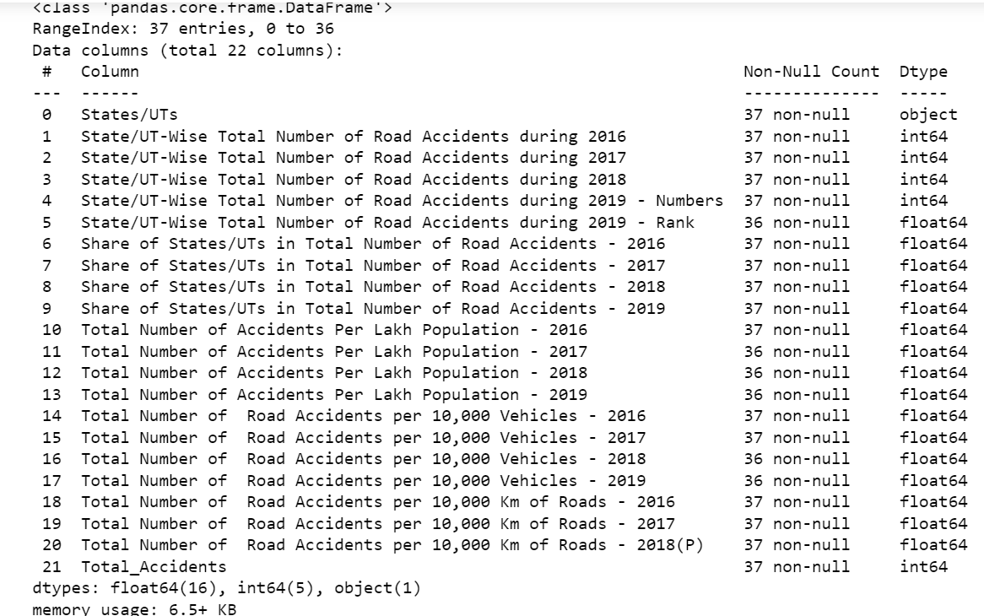
Data
Visualisation 1
Data
Visualisation 2
Data
handling
Data
collecting
Data
import
Management of data
Graphical representation of data
Collection of data
Mapping of data
importing python libraries
Data handling can result in efficient and economical storage, retrieval, and disposal of data.
Imports in Python are important for structuring your code effectively
Data visualization
removes the noise from data and highlights useful information.
Collect necessary data to work on it
The ability to absorb information quickly, improve insights and make faster decisions

Slide 15
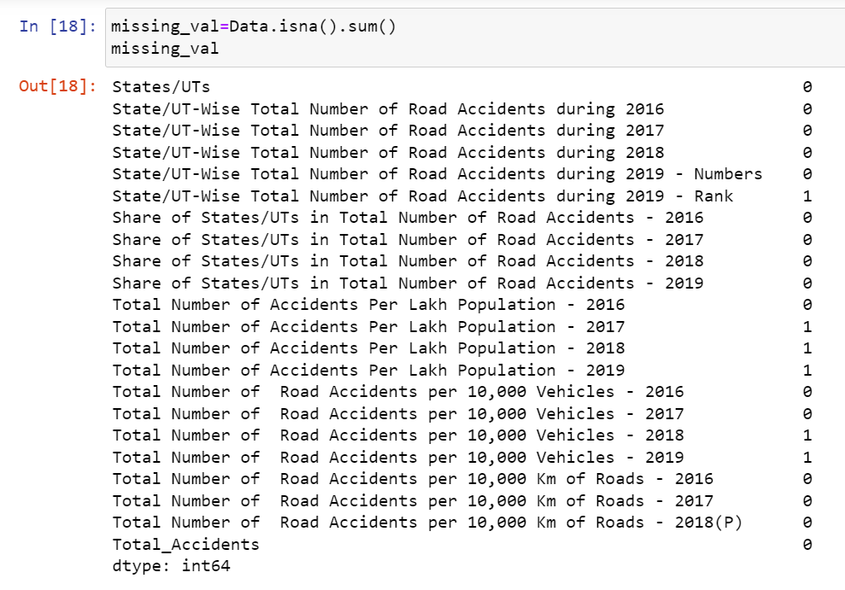
Data
Visualisation 1
Data
Visualisation 2
Data
handling
Data
collecting
Data
import
Management of data
Graphical representation of data
Collection of data
Mapping of data
importing python libraries
Data handling can result in efficient and economical storage, retrieval, and disposal of data.
Imports in Python are important for structuring your code effectively
Data visualization
removes the noise from data and highlights useful information.
Collect necessary data to work on it
The ability to absorb information quickly, improve insights and make faster decisions

Slide 16
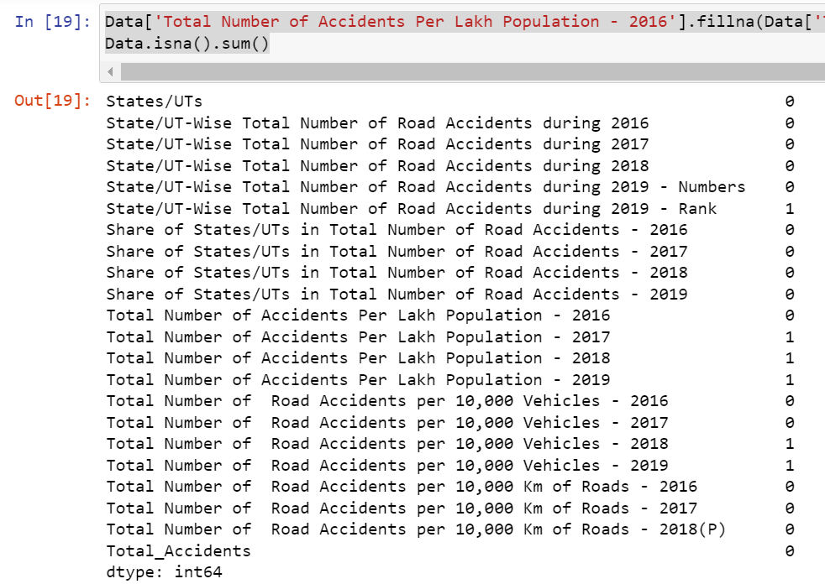
Data
Visualisation 1
Data
Visualisation 2
Data
handling
Data
collecting
Data
import
Management of data
Graphical representation of data
Collection of data
Mapping of data
importing python libraries
Data handling can result in efficient and economical storage, retrieval, and disposal of data.
Imports in Python are important for structuring your code effectively
Data visualization
removes the noise from data and highlights useful information.
Collect necessary data to work on it
The ability to absorb information quickly, improve insights and make faster decisions

Slide 17
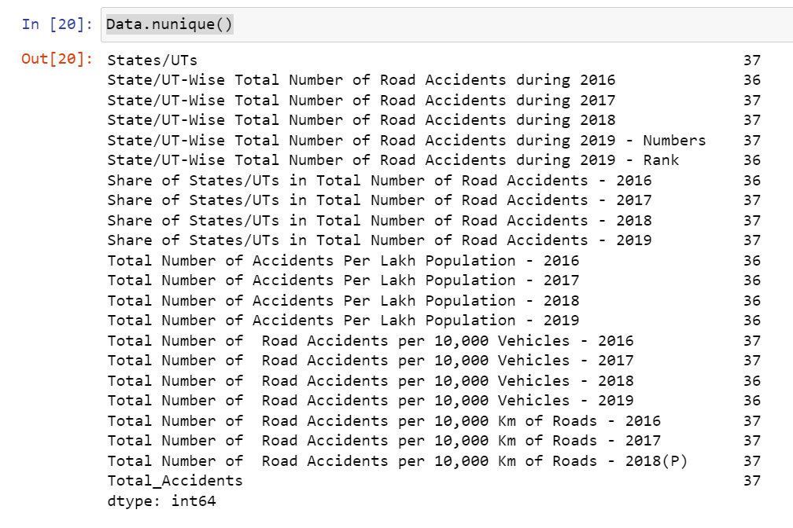
Data
Visualisation 1
Data
Visualisation 2
Data
handling
Data
collecting
Data
import
Management of data
Graphical representation of data
Collection of data
Mapping of data
importing python libraries
Data handling can result in efficient and economical storage, retrieval, and disposal of data.
Imports in Python are important for structuring your code effectively
Data visualization
removes the noise from data and highlights useful information.
Collect necessary data to work on it
The ability to absorb information quickly, improve insights and make faster decisions

Slide 18
Data
Visualisation 1
Data
Visualisation 2
Data
import
Data
handling
Data
collecting
Graphical representation of data
importing python libraries
Mapping of data
Management of data
Collection of data
Imports in Python are important for structuring your code effectively
Data visualization
removes the noise from data and highlights useful information.
Data handling can result in efficient and economical storage, retrieval, and disposal of data.
The ability to absorb information quickly, improve insights and make faster decisions
Collect necessary data to work on it

Slide 19
Data
Visualisation 1
Data
Visualisation 2
Code to implement no.of accidents every year in bar graph
Data
handling
Data
collecting
Data
import
import plotly.express as px
# Select columns for years and variables
years = ['2016', '2017', '2018', '2019']
variables = Data.columns[1:5] # Columns for the four years
# Melt the DataFrame to create a long-form representation
melted_Data = Data.melt(id_vars='States/UTs', value_vars=variables,
var_name='Year', value_name='Value')
# Create a bar plot using Plotly
fig = px.bar(melted_Data, x='States/UTs', y='Value', color='Year',
labels={'Value': 'Value', 'States/UTs': 'States/UTs'},
title='Variables Over the Years')
fig.update_layout(xaxis_title='States/UTs', yaxis_title='Value')
fig.show()
Management of data
Graphical representation of data
Collection of data
Mapping of data
importing python libraries
Data handling can result in efficient and economical storage, retrieval, and disposal of data.
Imports in Python are important for structuring your code effectively
Data visualization
removes the noise from data and highlights useful information.
Collect necessary data to work on it
The ability to absorb information quickly, improve insights and make faster decisions

Slide 20
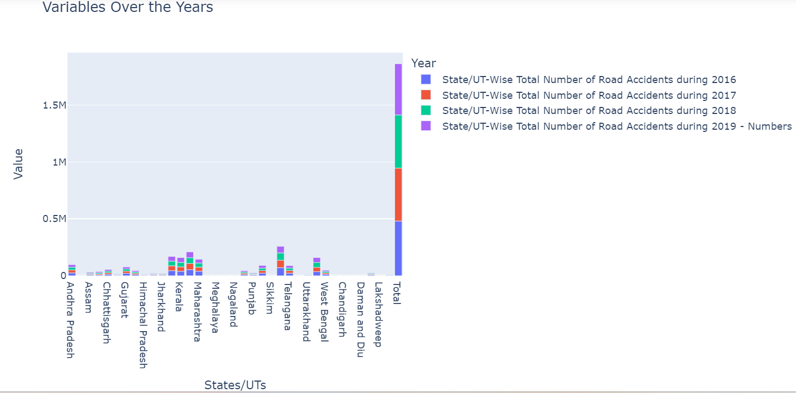
Data
Visualisation 1
Data
Visualisation 2
Overview & output
Data
handling
Data
collecting
Data
import
The given code creates a bar plot using Plotly Express to visualize data over the years for different states or union territories (States/UTs). It starts by melting the DataFrame Data to create a long-form representation, which is helpful for creating certain types of plots. The melted data is then used to create a bar plot.
The x-axis will represent the States/UTs.
The y-axis will represent the Value.
Management of data
Graphical representation of data
Collection of data
Mapping of data
importing python libraries
Data handling can result in efficient and economical storage, retrieval, and disposal of data.
Imports in Python are important for structuring your code effectively
Data visualization
removes the noise from data and highlights useful information.
Collect necessary data to work on it
The ability to absorb information quickly, improve insights and make faster decisions

Slide 21
Data
Visualisation 1
Data
Visualisation 2
Top 2 states with the most accidents
# Calculate the total accidents for each state
Data['Total_Accidents'] = Data[['State/UT-Wise Total Number of Road Accidents during 2016',
'State/UT-Wise Total Number of Road Accidents during 2017',
'State/UT-Wise Total Number of Road Accidents during 2018',
'State/UT-Wise Total Number of Road Accidents during 2019 - Numbers']].sum(axis=1)
# Get the top 2 states with the most accidents
top_states = Data.nlargest(3, 'Total_Accidents')
# Create plots using Plotly for the top 2 states
for index, row in top_states.iterrows():
state_name = row['States/UTs']
years = ['2016', '2017', '2018', '2019']
accidents = row[['State/UT-Wise Total Number of Road Accidents during 2016',
'State/UT-Wise Total Number of Road Accidents during 2017',
'State/UT-Wise Total Number of Road Accidents during 2018',
'State/UT-Wise Total Number of Road Accidents during 2019 - Numbers']]
fig = px.bar(x=years, y=accidents, title=f"Accidents in {state_name}",
labels={'x': 'Year', 'y': 'Number of Accidents'})
fig.update_layout(xaxis_title='Year', yaxis_title='Number of Accidents')
fig.show()
Data
handling
Data
collecting
Data
import
Management of data
Graphical representation of data
Collection of data
Mapping of data
importing python libraries
Data handling can result in efficient and economical storage, retrieval, and disposal of data.
Imports in Python are important for structuring your code effectively
Data visualization
removes the noise from data and highlights useful information.
Collect necessary data to work on it
The ability to absorb information quickly, improve insights and make faster decisions

Slide 22
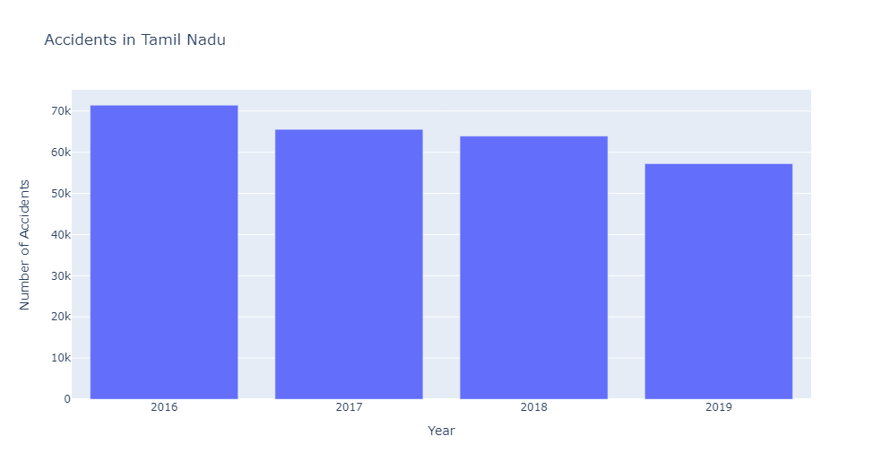
Data
Visualisation 1
Data
Visualisation 2
Overview & output
Data
handling
TOP 2 STATES HAVING MORE NUMBER OF ACCIDENTS:
The code will generate two separate bar plots, one for each of the top 2 states/UTs with the most accidents. The title of each plot will indicate the state/UT name, and the x-axis will represent the years, while the y-axis will represent the number of accidents for each year.
Data
collecting
Data
import
Management of data
Graphical representation of data
Collection of data
Mapping of data
importing python libraries
Data handling can result in efficient and economical storage, retrieval, and disposal of data.
Imports in Python are important for structuring your code effectively
Data visualization
removes the noise from data and highlights useful information.
Collect necessary data to work on it
The ability to absorb information quickly, improve insights and make faster decisions

Slide 23
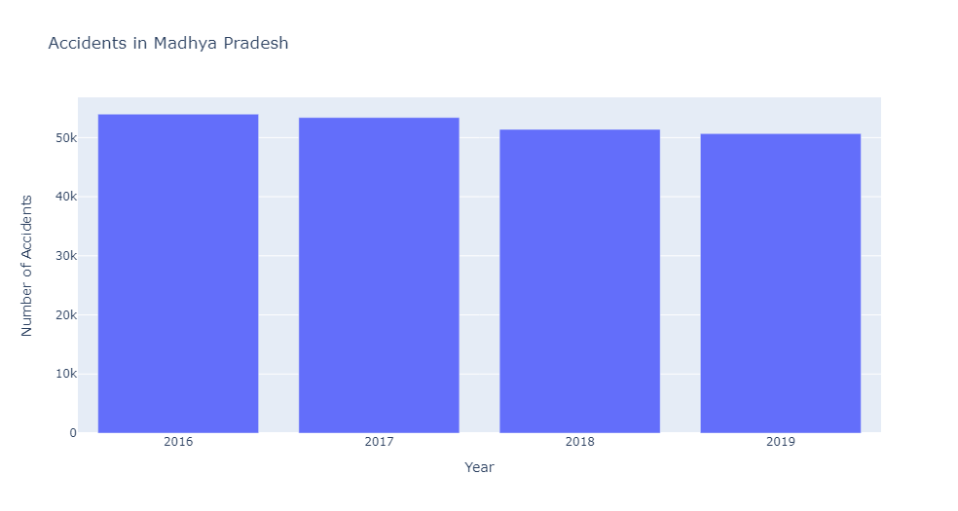
Data
Visualisation 1
Data
Visualisation 2
Overview & output
Data
handling
TOP 2 STATES HAVING MORE NUMBER OF ACCIDENTS:
The code will generate two separate bar plots, one for each of the top 2 states/UTs with the most accidents. The title of each plot will indicate the state/UT name, and the x-axis will represent the years, while the y-axis will represent the number of accidents for each year.
Data
collecting
Data
import
Management of data
Graphical representation of data
Collection of data
Mapping of data
importing python libraries
Data handling can result in efficient and economical storage, retrieval, and disposal of data.
Imports in Python are important for structuring your code effectively
Data visualization
removes the noise from data and highlights useful information.
Collect necessary data to work on it
The ability to absorb information quickly, improve insights and make faster decisions

Slide 24
Data
Visualisation 1
Data
Visualisation 2
Data
handling
Data
collecting
Data
import
Graphical representation of data
Mapping of data
Management of data
Collection of data
importing python libraries
Data visualization
removes the noise from data and highlights useful information.
Data handling can result in efficient and economical storage, retrieval, and disposal of data.
Imports in Python are important for structuring your code effectively
The ability to absorb information quickly, improve insights and make faster decisions
Collect necessary data to work on it

Slide 25
Data
Visualisation 1
Data
Visualisation 2
Graph 1: Total Accidents by State during 2019
Graph 2: Comparison of Accidents in 2016 and 2019 for the Top 5 States with Most Accidents
Graph 3: Ranking of Accidents by State in 2019
Graph 4: Percentage of Accidents in 2019 by State
Data
handling
Data
collecting
Data
import
# Graph 1: Total Accidents by State during 2019
fig1 = px.bar(Data, x='States/UTs', y='State/UT-Wise Total Number of Road Accidents during 2019 - Numbers',
title='Total Accidents by State during 2019')
fig1.update_layout(xaxis_title='State', yaxis_title='Number of Accidents')
fig1.show()
# Graph 2: Comparison of Accidents in 2016 and 2019 for the Top 5 States with Most Accidents
top_states = Data.nlargest(5, 'State/UT-Wise Total Number of Road Accidents during 2019 - Numbers')
fig2 = px.bar(top_states, x='States/UTs', y=['State/UT-Wise Total Number of Road Accidents during 2016', 'State/UT-Wise Total Number of Road Accidents during 2019 - Numbers'],
title='Comparison of Accidents in 2016 and 2019 for the Top 5 States with Most Accidents')
fig2.update_layout(xaxis_title='State', yaxis_title='Number of Accidents')
fig2.show()
# Graph 3: Ranking of Accidents by State in 2019
fig3 = px.bar(Data, x='States/UTs', y='State/UT-Wise Total Number of Road Accidents during 2019 - Rank',
Graphical representation of data
Management of data
Collection of data
Mapping of data
importing python libraries
Data visualization
removes the noise from data and highlights useful information.
Data handling can result in efficient and economical storage, retrieval, and disposal of data.
Imports in Python are important for structuring your code effectively
Collect necessary data to work on it
The ability to absorb information quickly, improve insights and make faster decisions

Slide 26
Data
Visualisation 1
Data
Visualisation 2
title='Ranking of Accidents by State in 2019')
fig3.update_layout(xaxis_title='State', yaxis_title='Ranking')
fig3.show()
# Graph 4: Percentage of Accidents in 2019 by State
fig4 = px.pie(Data, names='States/UTs', values='Share of States/UTs in Total Number of Road Accidents - 2019',
title='Percentage of Accidents in 2019 by State')
fig4.show()
Data
handling
Data
collecting
Data
import
Graphical representation of data
Management of data
Collection of data
Mapping of data
importing python libraries
Overview & output
Data visualization
removes the noise from data and highlights useful information.
Data handling can result in efficient and economical storage, retrieval, and disposal of data.
Imports in Python are important for structuring your code effectively
Collect necessary data to work on it
The ability to absorb information quickly, improve insights and make faster decisions
Graph 1: Shows the total number of road accidents for each state/union territory during the year 2019.
Graph 2: Compares the number of road accidents in 2016 and 2019 for the top 5 states/union territories with the highest accidents in 2019.
Graph 3: Presents a ranking of states/union territories based on the number of road accidents in 2019.
Graph 4: Displays a pie chart illustrating the percentage distribution of road accidents among different states/union territories in 2019.

Slide 27
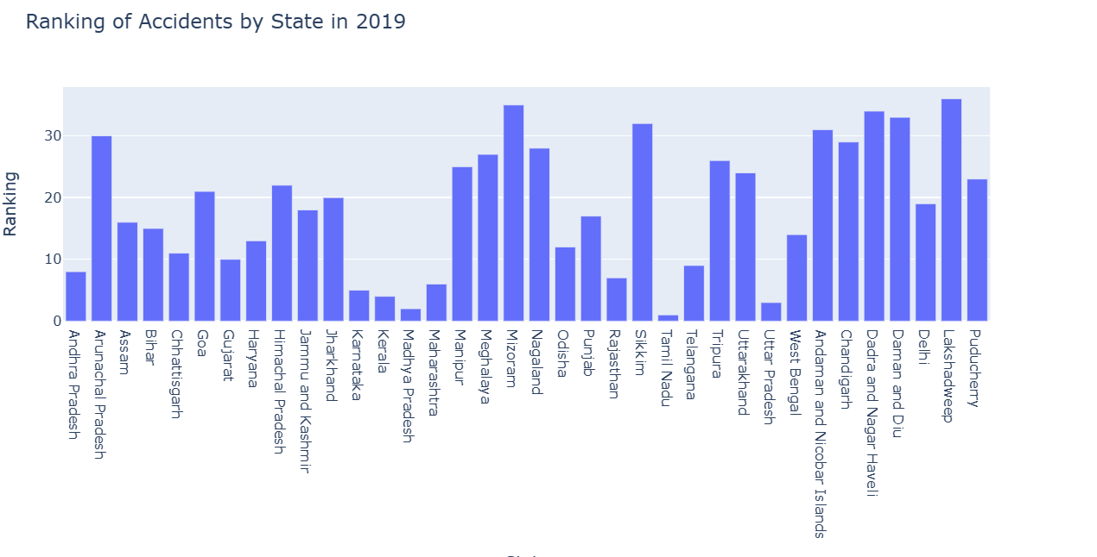
Data
Visualisation 1
Data
Visualisation 2
Data
handling
Data
collecting
Data
import
Graphical representation of data
Management of data
Collection of data
Mapping of data
importing python libraries
Data visualization
removes the noise from data and highlights useful information.
Data handling can result in efficient and economical storage, retrieval, and disposal of data.
Imports in Python are important for structuring your code effectively
Collect necessary data to work on it
The ability to absorb information quickly, improve insights and make faster decisions

Slide 28
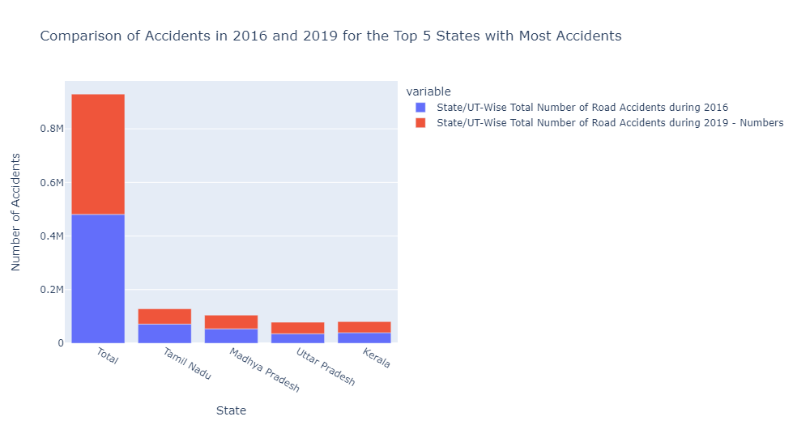
Data
Visualisation 1
Data
Visualisation 2
Data
handling
Data
collecting
Data
import
Graphical representation of data
Management of data
Collection of data
Mapping of data
importing python libraries
Data visualization
removes the noise from data and highlights useful information.
Data handling can result in efficient and economical storage, retrieval, and disposal of data.
Imports in Python are important for structuring your code effectively
Collect necessary data to work on it
The ability to absorb information quickly, improve insights and make faster decisions

Slide 29
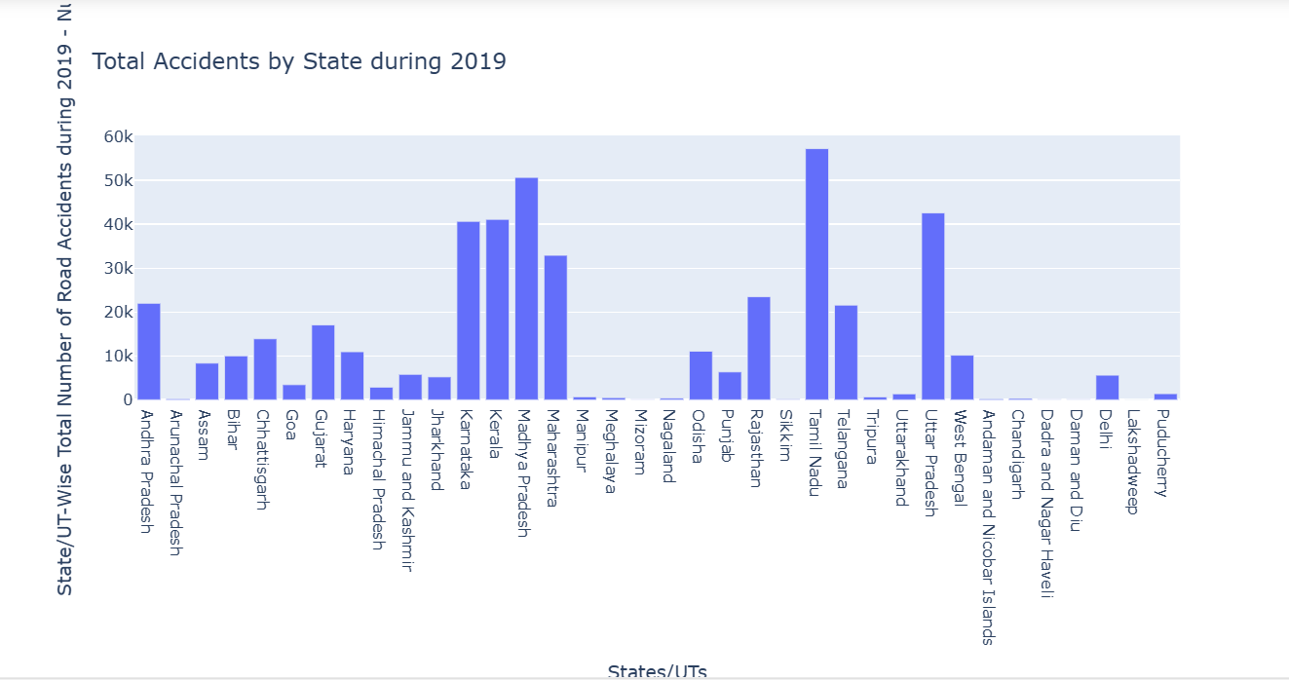
Data
Visualisation 1
Data
Visualisation 2
Data
handling
Data
collecting
Data
import
Graphical representation of data
Management of data
Collection of data
Mapping of data
importing python libraries
Data visualization
removes the noise from data and highlights useful information.
Data handling can result in efficient and economical storage, retrieval, and disposal of data.
Imports in Python are important for structuring your code effectively
Collect necessary data to work on it
The ability to absorb information quickly, improve insights and make faster decisions

Slide 30
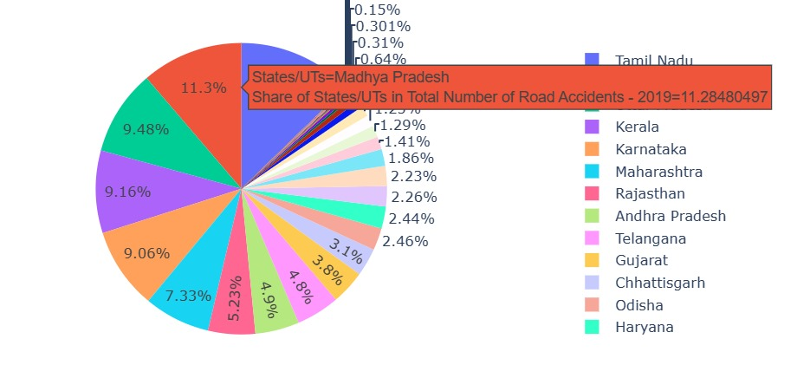
Data
Visualisation 1
Data
Visualisation 2
Data
handling
Data
collecting
Data
import
Graphical representation of data
Management of data
Collection of data
Mapping of data
importing python libraries
Data visualization
removes the noise from data and highlights useful information.
Data handling can result in efficient and economical storage, retrieval, and disposal of data.
Imports in Python are important for structuring your code effectively
Collect necessary data to work on it
The ability to absorb information quickly, improve insights and make faster decisions

Slide 31
Data
Visualisation 1
Data
Visualisation 2
Scatter plot
Data
handling
Data
collecting
Data
import
import matplotlib.pyplot as plt
import csv
States = []
accidents_2016 = []
with open(r"C:\Users\pathi\OneDrive\Desktop\Road Accidents 2016-19.csv") as csvfile:
lines = csv.reader(csvfile, delimiter=',')
for row in lines:
States.append(row[0])
accidents_2016.append(row[1])
plt.scatter(States, accidents_2016, color = 'b',s =1)
plt.xticks(rotation = 90)
plt.xlabel('States')
plt.ylabel('accidents_2016')
plt.title('scatter plot', fontsize = 20)
plt.show()
Graphical representation of data
Management of data
Collection of data
Mapping of data
importing python libraries
Data visualization
removes the noise from data and highlights useful information.
Data handling can result in efficient and economical storage, retrieval, and disposal of data.
Imports in Python are important for structuring your code effectively
Collect necessary data to work on it
The ability to absorb information quickly, improve insights and make faster decisions

Slide 32
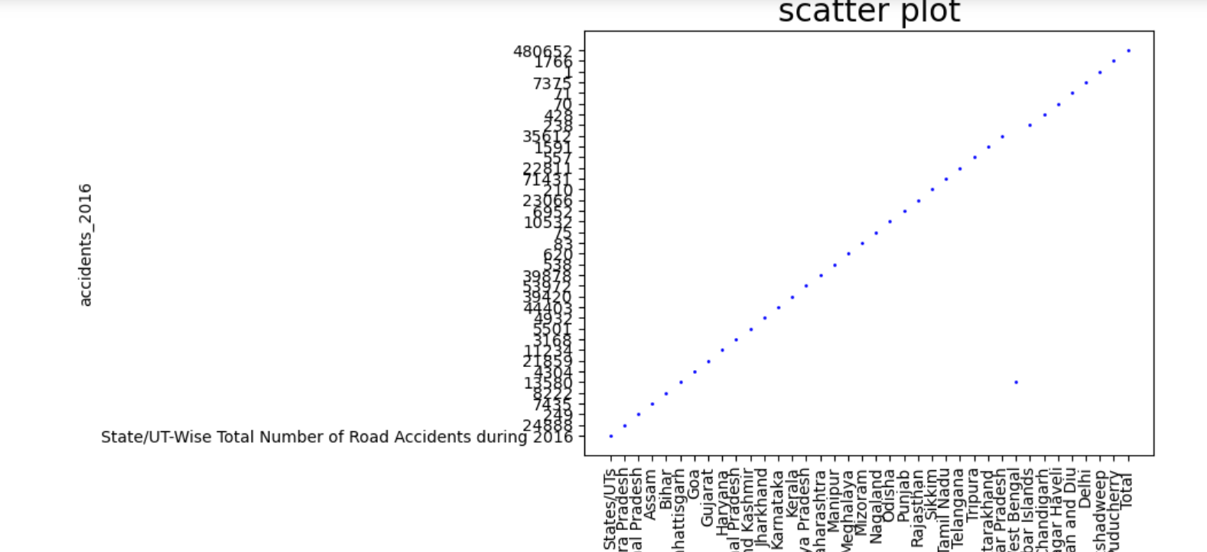
Data
Visualisation 1
Data
Visualisation 2
Overview & output
The Python code uses Matplotlib and CSV libraries to create a scatter plot. It reads data from a CSV file containing state-wise road accidents in 2016, extracts state names and accident counts, and visualizes the data with state names on the x-axis and accident counts on the y-axis. The plot is displayed with blue points, rotated x-axis labels, and appropriate axis labels and title.
Data
handling
Data
collecting
Data
import
Graphical representation of data
Management of data
Collection of data
Mapping of data
importing python libraries
Data visualization
removes the noise from data and highlights useful information.
Data handling can result in efficient and economical storage, retrieval, and disposal of data.
Imports in Python are important for structuring your code effectively
Collect necessary data to work on it
The ability to absorb information quickly, improve insights and make faster decisions

Slide 33
Data
Visualisation 1
Data
Visualisation 2
outlier detection
Data
handling
Data
collecting
Data
import
int_vars=['State/UT-Wise Total Number of Road Accidents during 2016','State/UT-Wise
Total Number of Road Accidents during 2017', 'State/UT-Wise Total Number of
Road Accidents during 2018',]
fig,axs=plt.subplots(nrows=1,ncols=3,figsize=(15,10))
axs=axs.flatten()
for i,var in enumerate(int_vars):
sns.boxplot(x=var,data=Data,ax=axs[i])
plt.tight_layout()
plt.show()
Graphical representation of data
Management of data
Collection of data
Mapping of data
importing python libraries
Data visualization
removes the noise from data and highlights useful information.
Data handling can result in efficient and economical storage, retrieval, and disposal of data.
Imports in Python are important for structuring your code effectively
Collect necessary data to work on it
The ability to absorb information quickly, improve insights and make faster decisions
Overview & output
This code creates a set of three box plots side by side using Seaborn and Matplotlib. It visualizes the distribution of data for three specific numerical variables representing the total number of road accidents for the years 2016, 2017, and 2018. The box plots are arranged in a single row within a figure of size 15 inches in width and 10 inches in height, and they are displayed for comparison.

Slide 34
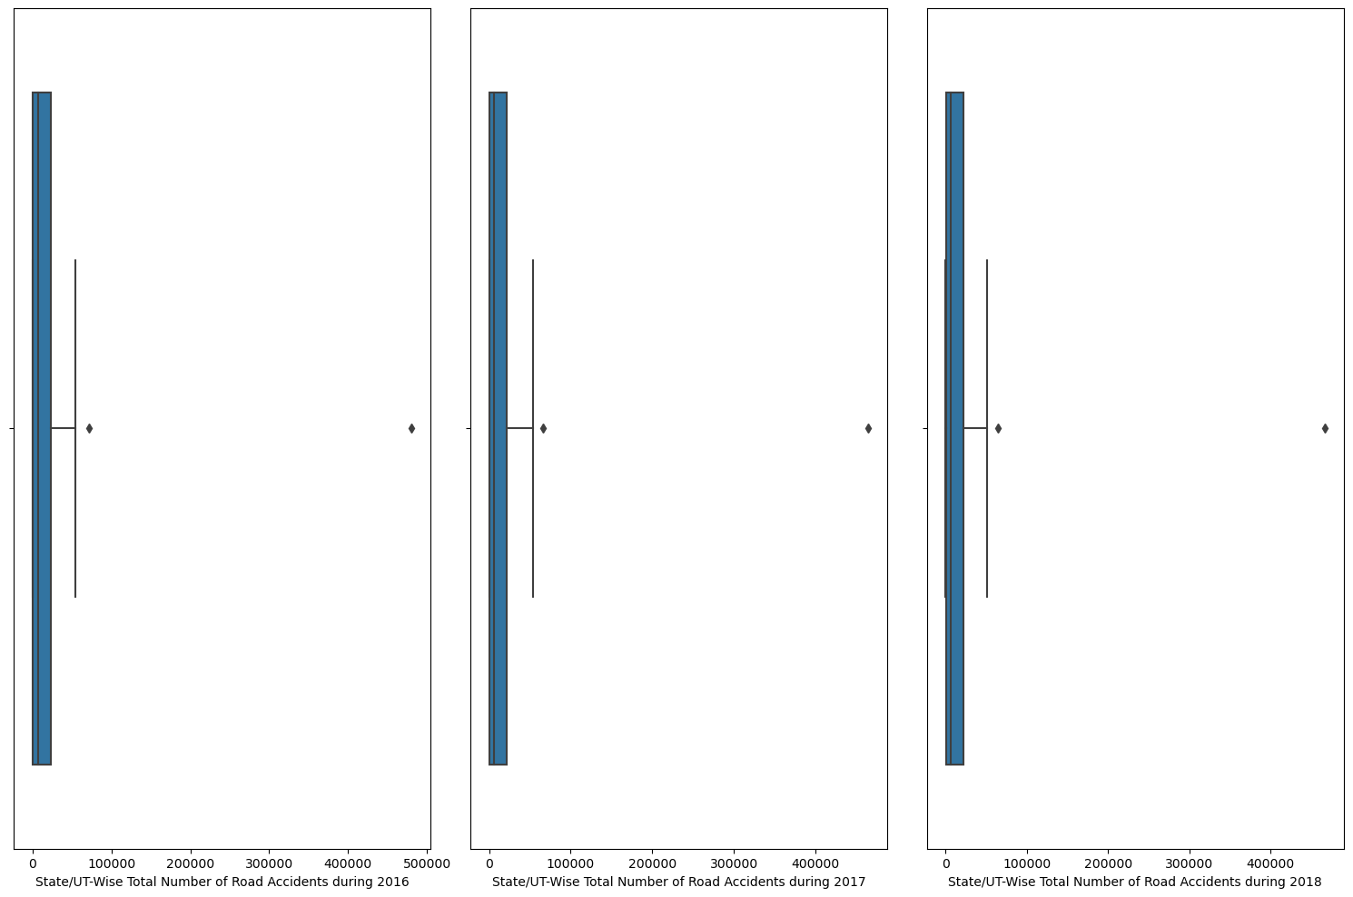
Data
Visualisation 1
Data
Visualisation 2
Data
handling
Data
collecting
Data
import
Graphical representation of data
Management of data
Collection of data
Mapping of data
importing python libraries
Data visualization
removes the noise from data and highlights useful information.
Data handling can result in efficient and economical storage, retrieval, and disposal of data.
Imports in Python are important for structuring your code effectively
Collect necessary data to work on it
The ability to absorb information quickly, improve insights and make faster decisions

Slide 35
Data
Visualisation 1
Data
Visualisation 2
Count plot
Data
handling
Data
collecting
Data
import
int_vars=['State/UT-Wise Total Number of Road Accidents during 2016','State/UT-Wise
Total Number of Road Accidents during 2017', 'State/UT-Wise Total Number of
Road Accidents during 2018’,]
fig,axs=plt.subplots(nrows=1,ncols=3,figsize=(10,10))
axs=axs.flatten()
for i,var in enumerate(int_vars):
sns.countplot(x=var,data=Data,ax=axs[i])
plt.tight_layout()
plt.show()
Graphical representation of data
Management of data
Collection of data
Mapping of data
importing python libraries
Data visualization
removes the noise from data and highlights useful information.
Data handling can result in efficient and economical storage, retrieval, and disposal of data.
Imports in Python are important for structuring your code effectively
Collect necessary data to work on it
The ability to absorb information quickly, improve insights and make faster decisions
Overview & output
This code generates three count plots side by side using Seaborn and Matplotlib. Each count plot visualizes the counts of specific categorical variables related to road accidents for the years 2016, 2017, and 2018. The plots are arranged in a single row within a figure of size 10 inches in width and 10 inches in height for easy comparison and are displayed accordingly.

Slide 36
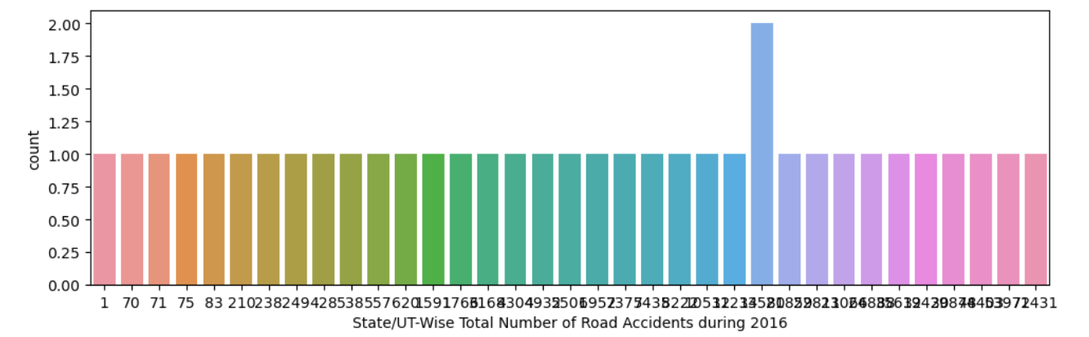
Data
Visualisation 1
Data
Visualisation 2
Data
handling
Data
collecting
Data
import
Graphical representation of data
Management of data
Collection of data
Mapping of data
importing python libraries
Data visualization
removes the noise from data and highlights useful information.
Data handling can result in efficient and economical storage, retrieval, and disposal of data.
Imports in Python are important for structuring your code effectively
Collect necessary data to work on it
The ability to absorb information quickly, improve insights and make faster decisions

Slide 37
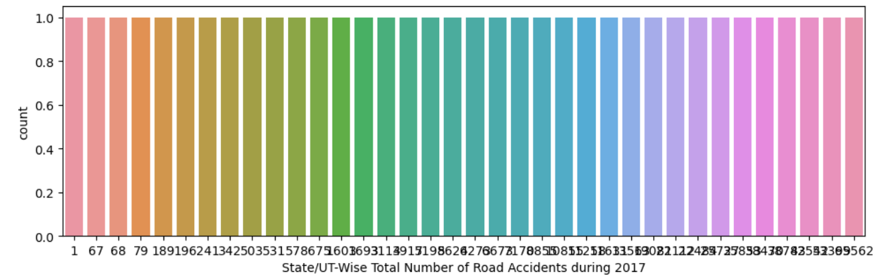
Data
Visualisation 1
Data
Visualisation 2
Data
handling
Data
collecting
Data
import
Graphical representation of data
Management of data
Collection of data
Mapping of data
importing python libraries
Data visualization
removes the noise from data and highlights useful information.
Data handling can result in efficient and economical storage, retrieval, and disposal of data.
Imports in Python are important for structuring your code effectively
Collect necessary data to work on it
The ability to absorb information quickly, improve insights and make faster decisions

Slide 38
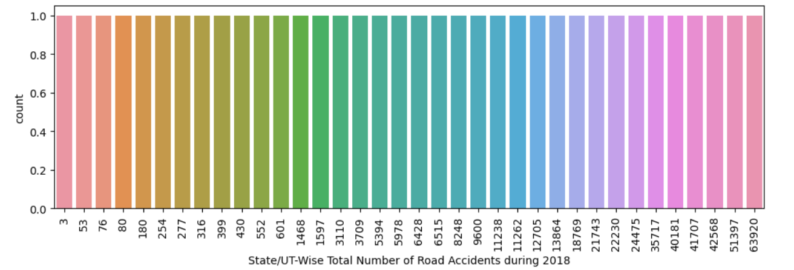
Data
Visualisation 1
Data
Visualisation 2
Data
handling
Data
collecting
Data
import
Graphical representation of data
Management of data
Collection of data
Mapping of data
importing python libraries
Data visualization
removes the noise from data and highlights useful information.
Data handling can result in efficient and economical storage, retrieval, and disposal of data.
Imports in Python are important for structuring your code effectively
Collect necessary data to work on it
The ability to absorb information quickly, improve insights and make faster decisions

Slide 39
Data
Visualisation 2
Data
Visualisation 1
Data
handling
Data
collecting
Data
import
Graphical representation of data
Mapping of data
Management of data
Collection of data
importing python libraries
Data visualization
removes the noise from data and highlights useful information.
The ability to absorb information quickly, improve insights and make faster decisions
Data handling can result in efficient and economical storage, retrieval, and disposal of data.
Imports in Python are important for structuring your code effectively
Collect necessary data to work on it

Slide 40

Data
Visualisation 2
Data
Visualisation 1
Data
Visualisation 3
Data
handling
Data
collecting
Data
import
Graphical representation of data
Mapping of data
Management of data
Collection of data
importing python libraries
tableau
Tableau is a powerful data visualization software tool that allows to analyze and visualize data in a meaningful and interactive way.
Data visualization
removes the noise from data and highlights useful information.
The ability to absorb information quickly, improve insights and make faster decisions
Data handling can result in efficient and economical storage, retrieval, and disposal of data.
Imports in Python are important for structuring your code effectively
Collect necessary data to work on it

Slide 41
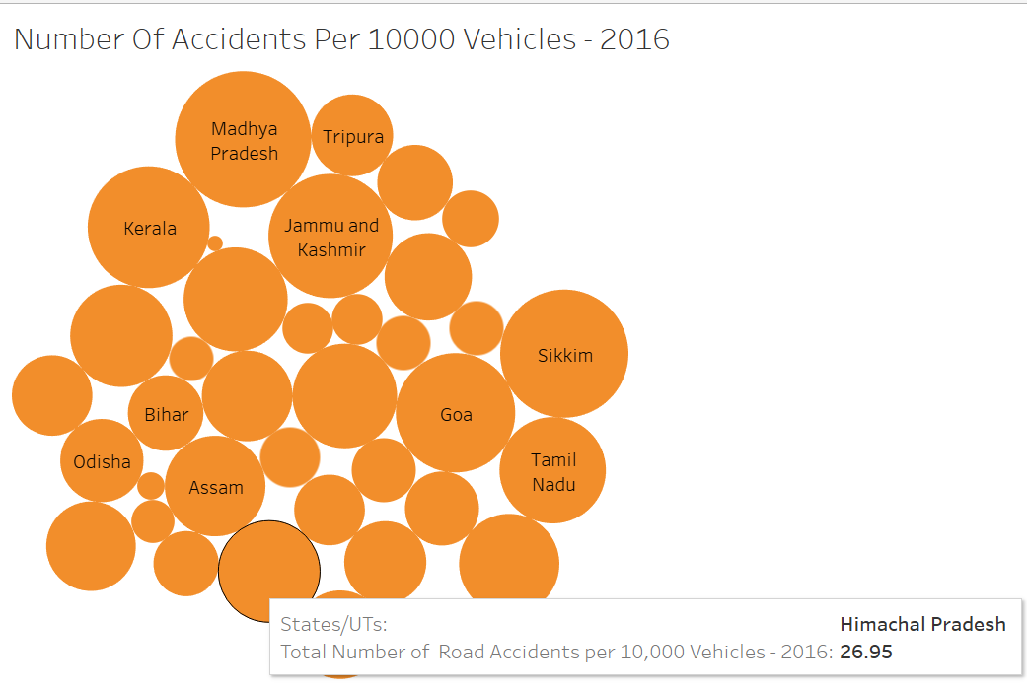
Data
Visualisation 2
Data
Visualisation 1
Packed bubbles visualisation
Data
Visualisation 3
Data
handling
COLUMNS = STATES/UT
ROW = NO.OF ACCIDENTS PER 10,000 VEHICLES
Data
collecting
Data
import
Graphical representation of data
Mapping of data
Management of data
Collection of data
importing python libraries
tableau
Tableau is a powerful data visualization software tool that allows to analyze and visualize data in a meaningful and interactive way.
Data visualization
removes the noise from data and highlights useful information.
The ability to absorb information quickly, improve insights and make faster decisions
Data handling can result in efficient and economical storage, retrieval, and disposal of data.
Imports in Python are important for structuring your code effectively
Collect necessary data to work on it

Slide 42
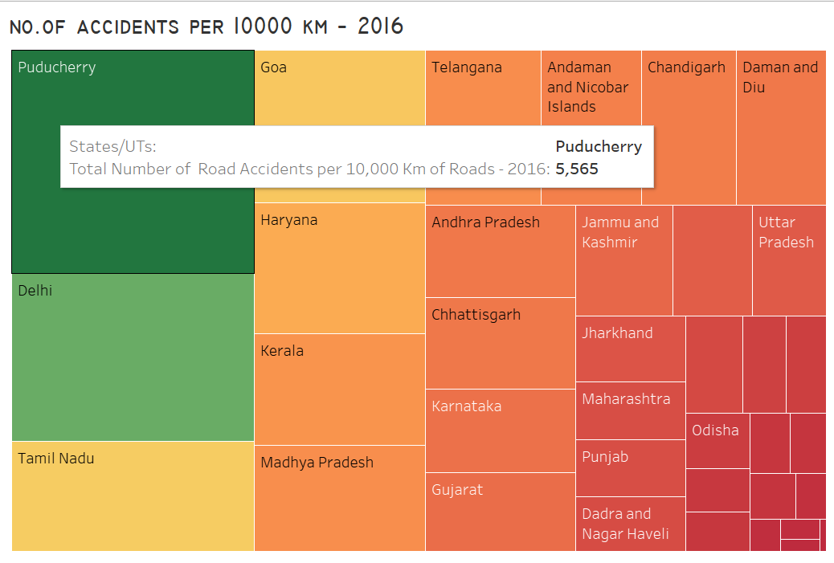
Data
Visualisation 2
Data
Visualisation 1
Tree map visualisation
Data
Visualisation 3
Data
handling
Data
collecting
COLUMNS = STATES/UT
ROW = NO.OF ACCIDENTS PER 10,000 KM
Data
import
Graphical representation of data
Mapping of data
Management of data
Collection of data
importing python libraries
tableau
Tableau is a powerful data visualization software tool that allows to analyze and visualize data in a meaningful and interactive way.
Data visualization
removes the noise from data and highlights useful information.
The ability to absorb information quickly, improve insights and make faster decisions
Data handling can result in efficient and economical storage, retrieval, and disposal of data.
Imports in Python are important for structuring your code effectively
Collect necessary data to work on it

Slide 43
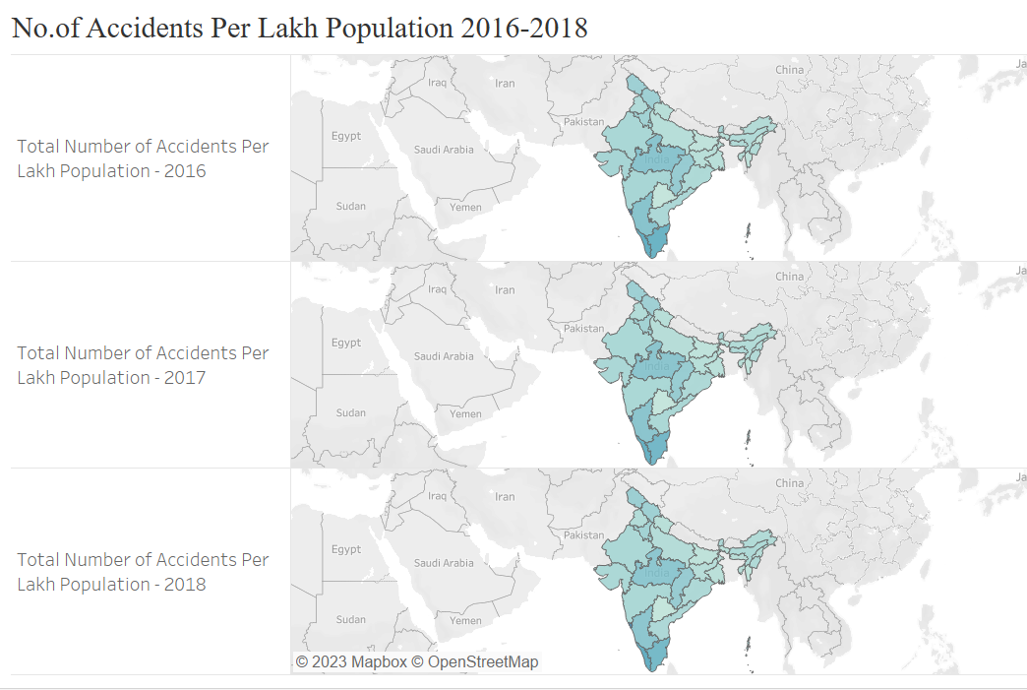
Data
Visualisation 2
Data
Visualisation 1
map visualisation
Data
Visualisation 3
Data
handling
COLUMNS = STATES/UT
ROW = NO.OF ACCIDENTS PER LAKH POPULATION
Data
collecting
Data
import
Graphical representation of data
Mapping of data
Management of data
Collection of data
importing python libraries
tableau
Tableau is a powerful data visualization software tool that allows to analyze and visualize data in a meaningful and interactive way.
Data visualization
removes the noise from data and highlights useful information.
The ability to absorb information quickly, improve insights and make faster decisions
Data handling can result in efficient and economical storage, retrieval, and disposal of data.
Imports in Python are important for structuring your code effectively
Collect necessary data to work on it

Slide 44
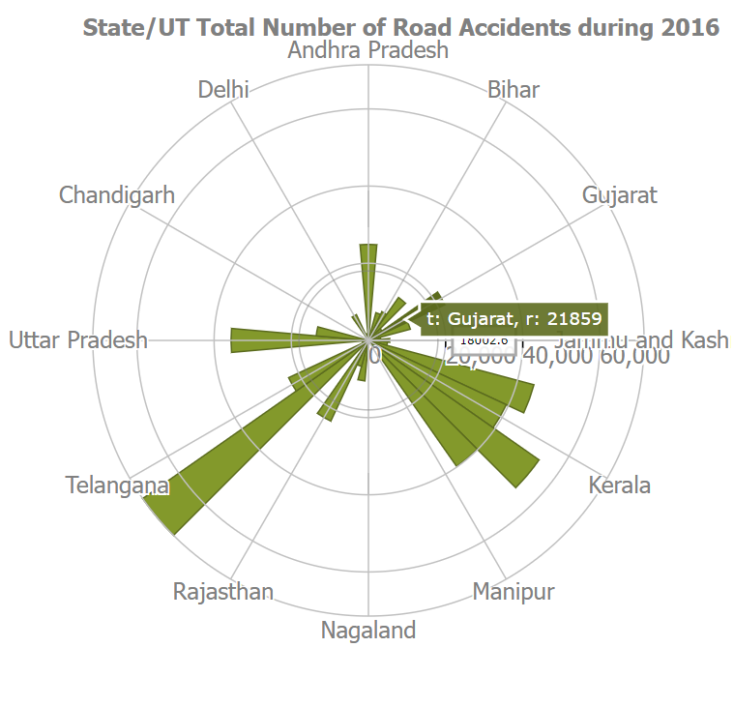
Data
Visualisation 2
Data
Visualisation 1
Rose chart visualisation
Data
Visualisation 3
Data
handling
Data
collecting
Data
import
Graphical representation of data
Mapping of data
Management of data
Collection of data
importing python libraries
tableau
Tableau is a powerful data visualization software tool that allows to analyze and visualize data in a meaningful and interactive way.
Data visualization
removes the noise from data and highlights useful information.
The ability to absorb information quickly, improve insights and make faster decisions
Data handling can result in efficient and economical storage, retrieval, and disposal of data.
Imports in Python are important for structuring your code effectively
Collect necessary data to work on it

Slide 45
Data
Visualisation 2
Data
Visualisation 1
Data
Visualisation 3
Data
handling
Data
collecting
Data
import
Graphical representation of data
Mapping of data
Management of data
Collection of data
importing python libraries
tableau
Tableau is a powerful data visualization software tool that allows to analyze and visualize data in a meaningful and interactive way.
Data visualization
removes the noise from data and highlights useful information.
The ability to absorb information quickly, improve insights and make faster decisions
Data handling can result in efficient and economical storage, retrieval, and disposal of data.
Imports in Python are important for structuring your code effectively
Collect necessary data to work on it

Slide 46

CONCLUSION
In conclusion, our data handling and visualization project on road accidents in India from 2016 to 2019 has provided valuable insights into the state of road safety in the country during this period Through careful data collection, analysis, and visualization.
Increasing Trend: The project revealed a consistent increase in the number of road accidents in India from 2016 to 2019.
Geographical Variations: Certain states and cities showed higher accident rates than others, suggesting the need for region-specific safety measures.
Visualization Tools: Interactive charts, graphs, and maps were used to make complex data easily understandable and accessible.
our data handling and visualization project not only provided a comprehensive overview of road accidents in India from 2016 to 2019 but also offered actionable insights that can contribute to reducing accidents and saving lives on the nation's roads.

Slide 47


